Slide 1
GitHub
Ways of Working Recap
Sep 25
South East Data & Analytics Team
england.datasouth@nhs.net
All data is for management information purposes and is not for wider circulation or publication
Notes:
Standard title slide

Slide 2
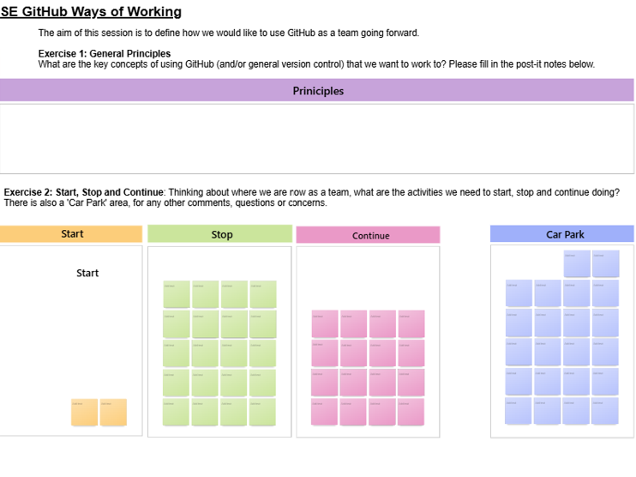
Ways of working session
What are the general principles / key concepts of using GitHub that we want to work to?
What are the things we want to Start, Stop, Continue doing when using GitHub?
Notes:
Plain slide with subhead and bullets

Slide 3
4 team principles for using GitHub
1
2
We use GitHub as the main source for all code
We support our team to use GitHub
We have one version of our code, which is stored on GitHub. We do not save code in shared areas. GitHub is the ‘organisational memory’ for all work; main is the production version for all our code, and we utilise branches for development work and QA.
We have clear and detailed documentation covering all elements of GitHub. We support each other to learn new things by offering training, drop-in sessions and having dedicated, team GitHub champions.
3
4
We standardise resources across the team
Our ways of working align with the wider NHS
We have a standard structure for all repositories and use shared code across the team. This includes:
Repository template
Readme template
Shared code and functions
Repository naming conventions
Our ways of working align with the wider organisation.
We share our code with other NHSE teams and collaborate using GitHub where possible. We make repositories public where appropriate.
Notes:
Plain slide with subhead and bullets

Slide 4
1. We use GitHub as the main source for all code
GitHub by default
We have one version of our code which is stored on GitHub. We do not save code in shared areas (e.g. SharePoint).
We create one repository per project.
We clone the GitHub repository to our personal areas rather than a shared area.
The main branch on GitHub is the production version of our code (QA’d and ready to use).
All code is available on GitHub; data, file paths, lakemart paths and outputs are hidden.
Making changes
GitHub is the ‘organisational memory’ for all work.
All development work is completed on a branch, with a new branch created for each significant update.
We commit regularly and focus on committing small changes rather than large updates.
QA & code reviews
All work completed on a branch is QA’d before merging into main.
We do regular code reviews to support team development.
We use ‘Issues’ to aid QA and to log ideas for future iterations.
Notes:
Plain slide with subhead and bullets

Slide 5
2. We support our team to use GitHub
Learning & development
We support each other to learn new things.
We ensure everyone can start using GitHub, with training that starts from the basics of using GitHub.
We offer training in small, logical steps towards an end goal.
We offer regular drop-ins and have dedicated GitHub Champions that can be approached for extra support.
Team documentation
We have clear and detailed guidance and documentation covering all elements of using GitHub.
Our training resources are thorough and assume no prior knowledge of GitHub.
We have easy to understand guides for non-coding members.
Notes:
Plain slide with subhead and bullets

Slide 6
3. We standardise resources across the team
Standardised repositories
We have a standard SE repository template used for all repositories, which includes and ReadMe template, a standard .gitignore and licenses.
    We follow standardised naming conventions for all repositories.
    Process standardisation
  We have shared functions that are used across the team.
  We have standardised processes, including commenting and QA’ing.
We have a standardised process for moving a repository from private to public.
4. Our ways of working align with the wider NHS
We follow best practice to ensure other NHSE teams understand our processes.
We share our code with other NHSE teams and collaborate using GitHub where possible.
We make repositories public where appropriate.
Notes:
Plain slide with subhead and bullets

Slide 7
GitHub Milestones
= Deadline
Q1
Q2
Q3
Q4
Skills
&
WoW
GitHub approach
GitHub embedded into WoW
Review existing code that is not on GitHub
Milestone 1
Milestone 2
Milestone 3
Milestone 4
GitHub
Log in to GitHub
Navigate to SE team area
Navigate to a SE repository
Create a repository using the SE template
Clone a repository
Understand the basics of a git ignore (using SE template)
Create a branch
Make commits
Fully understand a git ignore and manage across multiple IDEs (e.g. R Studio, DataBricks, VS Code)
Create a pull request
Fetch / pull changes
Merge a pull request
Use GitHub for the QA process
Collaborating using GitHub (e.g., project boards)
Raise issues
Roll back changes to a previous version
All new code is on GitHub
Milestone 1 Deadline
Milestone 2 Deadline
Milestone 3 Deadline

Slide 8

Specific question: Any new code since June which is not on GitHub?
GitHub Milestones
= Done
= Milestone tasks
= Additional tasks
= L&D session
= Deadline
1st team survey
Q1
2nd team survey
Q2
3rd team survey
Q3
4th team survey
Q4
Milestone 1
Intro to GitHub L&D sessions (2)
SLT session
Git Ignore guidance
Git Ignore L&D Session (1)
(August)*
Milestone 2
Additional L&D sessions as required
*not needed
Review 2nd survey results
Guidance for rolling back changes
Milestone 3
QASAR session L&D session (1)
Rolling back changes L&D session (1)
Start sharing resources on Regional Coding Matrix
GitHub ways of working – define naming conventions, saving repo link to SharePoint etc. Link in with governance and share with team.
Additional Tasks
Define role of GitHub champions and additional support offer
Implementation of GitHub champions / additional support
Code review sessions
GitHub Ways of Working (21st August)
* Provisional date
Milestone 1 Deadline
Milestone 2 Deadline
Milestone 3 Deadline

